Slide 1
Delivering Value through DevSecOps: a Post-Incident Review
David Hawthorne | davidhawthorne.com | @shellninja Director, Cloud Engineering at O3 Solutions
@shellninja
Notes:
This is a story about what happened when began to understand the dynamics of the business and the systems in organization

Slide 2

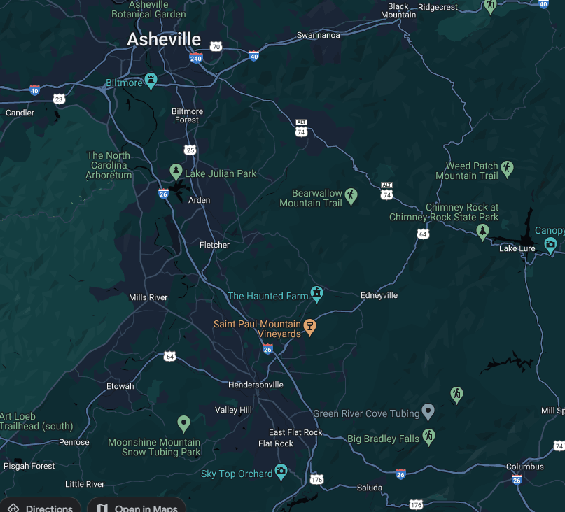




David Hawthorne
Director, Cloud Engineering O3 Solutions
Links: https://davidhawthorne.com
https://github.com/shellninja
Most platforms: @shellninja

Slide 3












BY THE NUMBERS
10 SOLUTION AREAS
92% CLIENT SATISFACTION
10+ OWNERS
20,000+ USERS
550+
PROJECTS
50+
CONTRACTORS
18% PRODUCTIVITY IMPROVEMENT
10 WORK PACKAGE TYPES
10+ EPC FIRMS
58 NPS SCORE
1 COMPREHENSIVE
PLATFORM
Notes:
O3 is the market leading agile software built specifically to support Advanced Work Packaging (AWP). It’s the only solution on the market with true work package management. No matter the size of the project, from small-cap to mega projects, O3 is scalable and can support your AWP maturity journey. ​
Here’s a quick snapshot of O3 by the numbers. Some highlights include O3 being used on over 550 projects worldwide which includes Owners, EPCs and Contractors. Of those organizations there are over 20 thousand users managing over 10 types of work packages all on one single platform. And we have a very high NPS score as well as client satisfaction rate. O3 is the market leading agile software built specifically to support Advanced Work Packaging (AWP). It’s the only solution on the market with true work package management. No matter the size of the project, from small-cap to mega projects, O3 is scalable and can support your AWP maturity journey.

Slide 4

Security is a kitchen table issue
@shellninja
Notes:
This is a story about how you can build a ISMP on a low budget, make audits suck less, and improve how we communicate with/to/from security. This is the hardest thing I’ve ever done in my career, and I hope to make it easy for you all.
As developers we build Hello World, not Hello Secure World. That’s one reason I’m excited about projects like .NET Aspire that provide an opinionated cloud resource deployments – secure by default.
I had seen security done right, seen it done bad. But I’m no CISSP, or other certification… I’m a factotum with a little industry experience working in compliance environments. I’d been a developer, sys admin, data and software architect roles so I spoke the language.
Everyone deserves security right? 50% have been in data breaches.

Slide 5


Slide 6
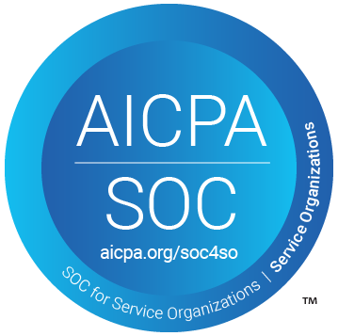
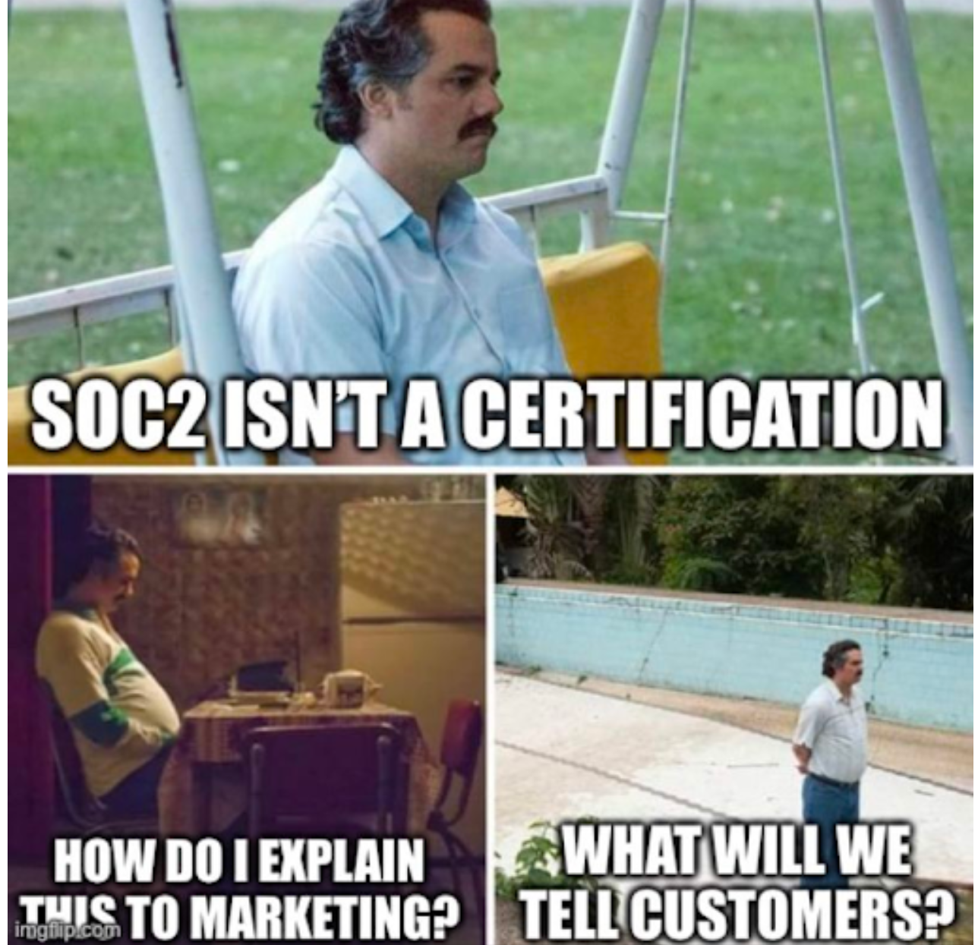
Incident: Achieve SOC 2 Compliance in under 90 days
Compliance Framework
Security
Availability
Processing Integrity
Confidentiality
Privacy
@shellninja
Notes:
SOC 2 compliance is a framework that ensures organizations securely manage and protect customer data by adhering to rigorous controls based on trust service principles like security, availability, processing integrity, confidentiality, and privacy.

Slide 7



Where we started: Strong DevOps culture Lean, Agile Scrum – Done Right Full CI/CD with TESTS Fully integrated operational data store Do more with less
@shellninja
Notes:
No scrumfall, Bugs go into the top of the sprint and knocked out first
We've fully integrated an operational data store that seamlessly connects with every system across our business, ensuring comprehensive and unified access to all critical data.
Being Lean/Agile haD made us successful
In a team with high-trust, this incredible environment works against you
We’re putting in barriers, without established value
Need to clear self openers
Sometimes there’s only two eyes to do merge.

Slide 8
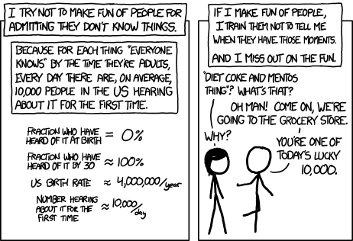
Saying 'what kind of an idiot doesn't know about the Yellowstone supervolcano' is so much more boring than telling someone about the Yellowstone supervolcano for the first time.
https://xkcd.com/1053
@shellninja
Notes:
How do you build a CoE when you’re something that doesn’t scale

Slide 9


Choose your role wisely.
@shellninja
Notes:
Say “the auditors will ask for X, if we do this it will cause an exception”
Call out Marcel on this one

Slide 10

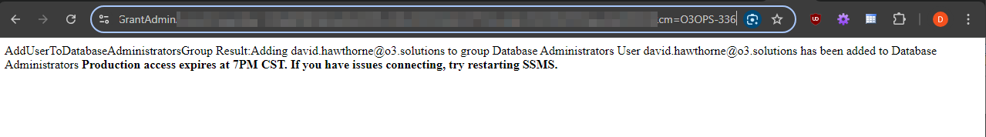
You need to make CM for that!
@shellninja
Notes:
Evidence requests are tests after all, eh? We already do a ton of TDD, what if we treated our evidence requests as unit tests?

Slide 11
Three years later:
Sustainable security program & strong DevSecOps culture
The business is aligned with SOC
Doubled the size of the team
@shellninja
Notes:
How do you build a CoE when you’re something that doesn’t scale

Slide 12

@shellninja

Slide 13

SOC 2
What went well
What didn’t go Well
Rethinking instead of remediating
Audit ready in 1 month, took 90 days.
Rapid IaC development
Expanded analytics
Impression of automated compliance
In a team with a lot of trust, sometimes it can be hard to introduce new language.
Aligning the SOC program to the business
@shellninja
Notes:
It takes ~6 months for a feature to become adopted. It takes a year to hit steady state.

Slide 14
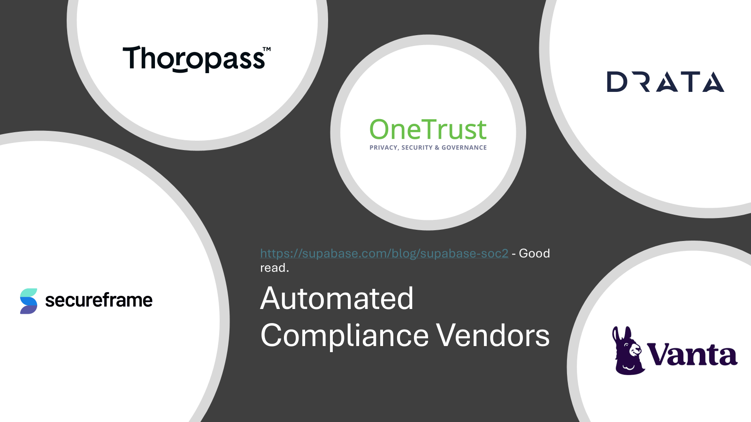

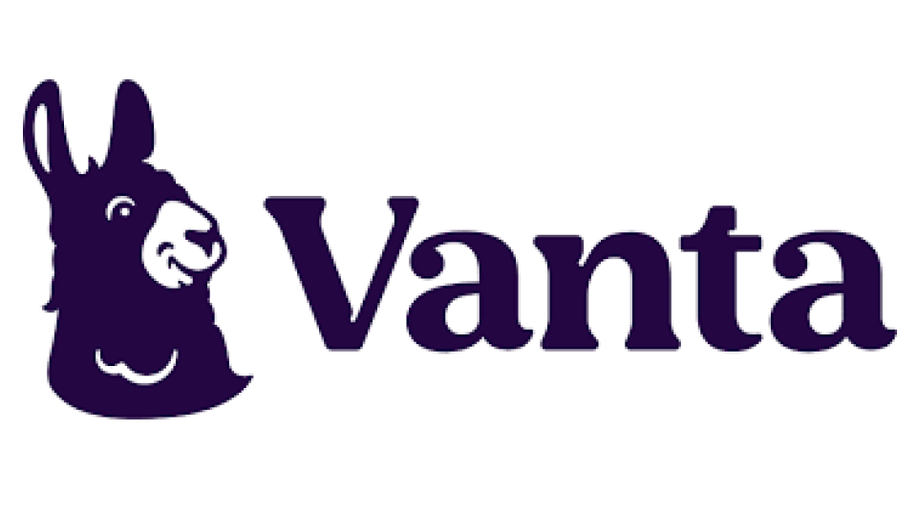


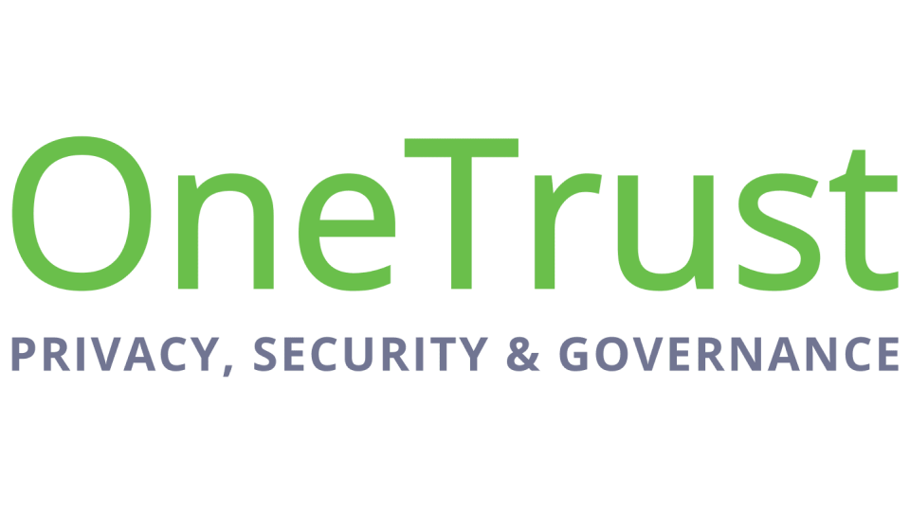
Automated Compliance Vendors
https://supabase.com/blog/supabase-soc2 - Good read.
Notes:
Chose a vendor with an alpha product

Slide 15
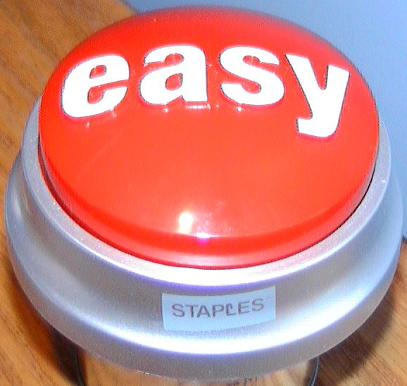
Automated Compliance:
Audit ready in two weeks
Integrate your systems
Expenses
@shellninja
Notes:
Easy buttons keep time linear
Allow me to stay in flow
Redefine our work
Glorified To-do list
A few steampipe queries “select * from cloud?”
But there’s hope
The “compliance architects” can be helpful in ensuring prep, and then
If you do everything in there, you’d easily have $100k overnight
You don’t have to, but if your provider is AWS and you’re in Azure… good luck
Not recognized by CSA so we’re looking at PwC

Slide 16
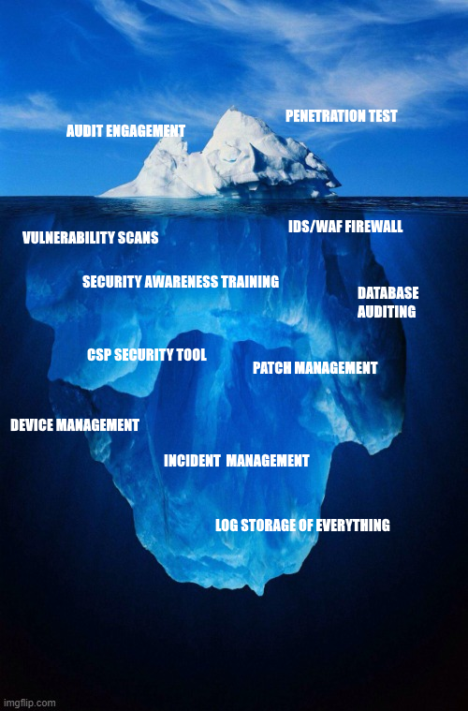
$10k-40k Estimated
Pentest
Vulnerability Scans*
IDS/Firewall
Database Auditing
Log Storage & Retention
Security Awareness Training*
Device Management and Patching*
https://davidhawthorne.com
Notes:
Asterisk are optional, but recommended.

Slide 17
RETHINK
Id the need
Collaborative Inclusion
Org-Wide adoption
Share
@shellninja
Notes:
Strategic
Cost Effective
People are excited
Hey HR, we have an LMS now – think you can use that for training on lawful hiring?

Slide 18
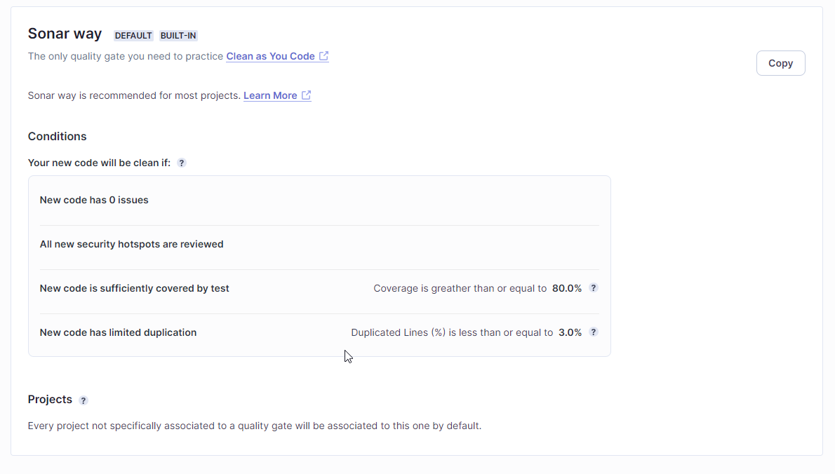

What if a tool could do more? Test your code for vulnerabilities . Scale the team by creating quality gates.
https://www.sonarsource.com/products/sonarqube/
@shellninja

Slide 19
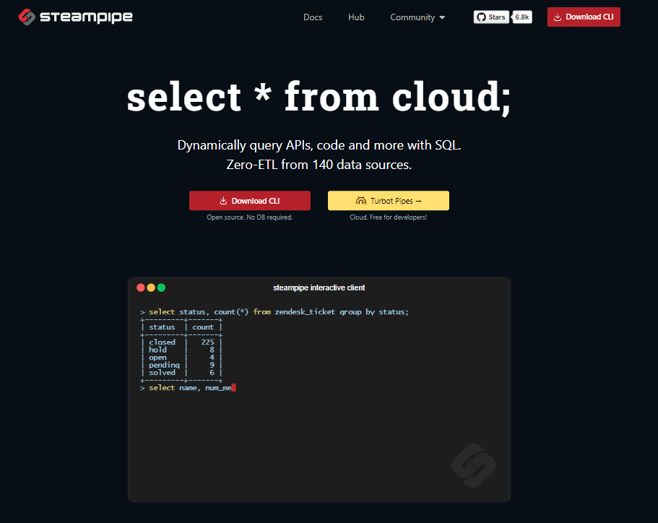
Steampipe
Query ANYTHING.
Spin up a container instance in a few lines, warehouse the data, shorten the loop.
@shellninja

Slide 20
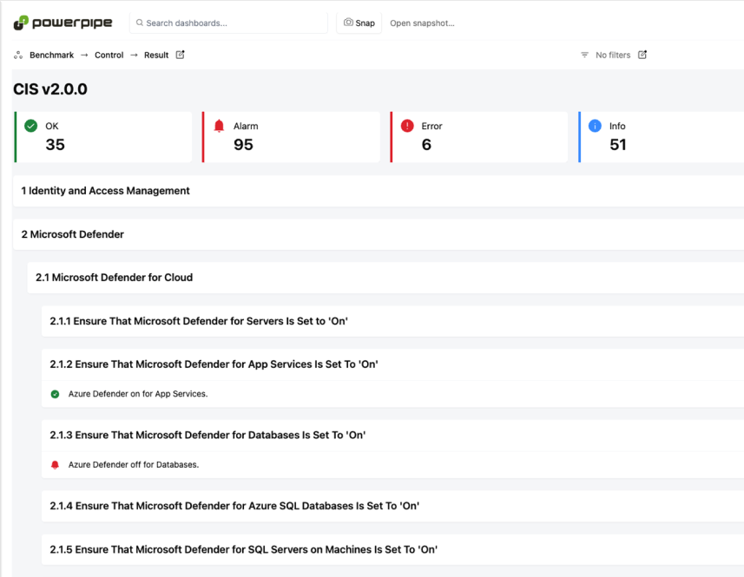
Dashboards
https://steampipe.io
CIS, HIPAA HITRUST, PCI-DSS, NIST SP 800-171, and more
Not limited to cloud resources – Entra, 1Password, Jira, Keycloak, Kubernetes, and more: Plugin Directory
All the stuff
@shellninja

Slide 21
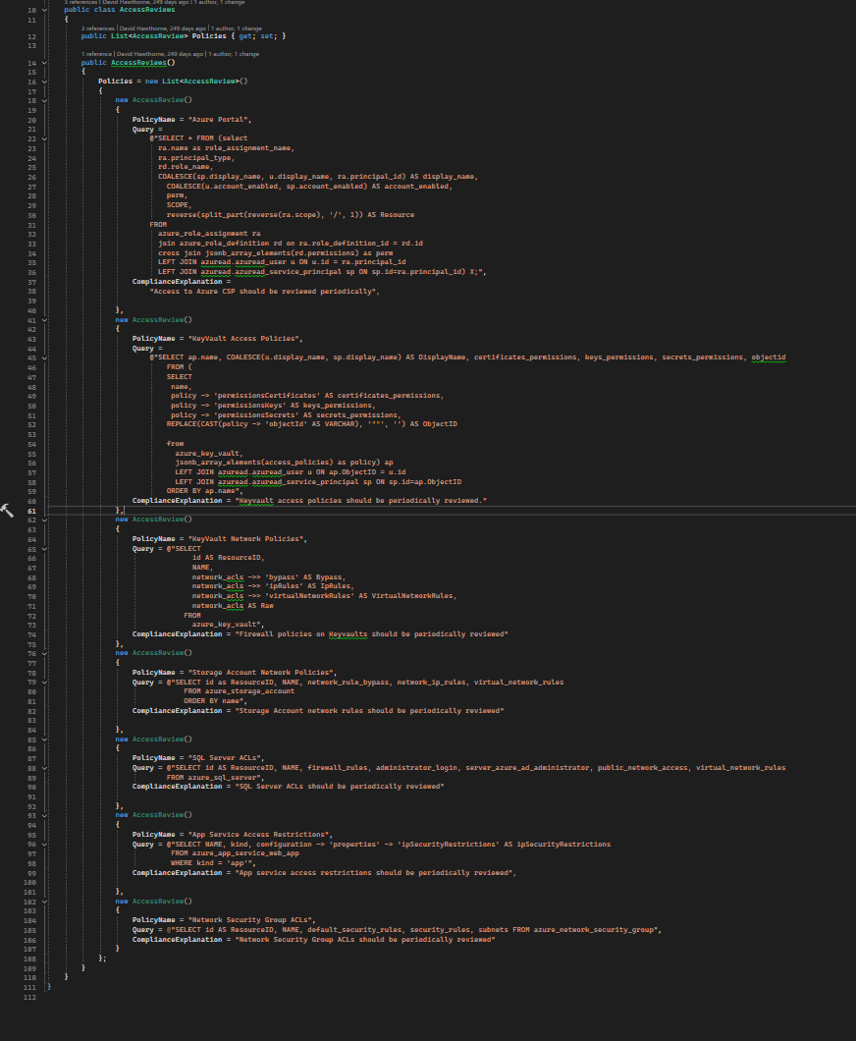
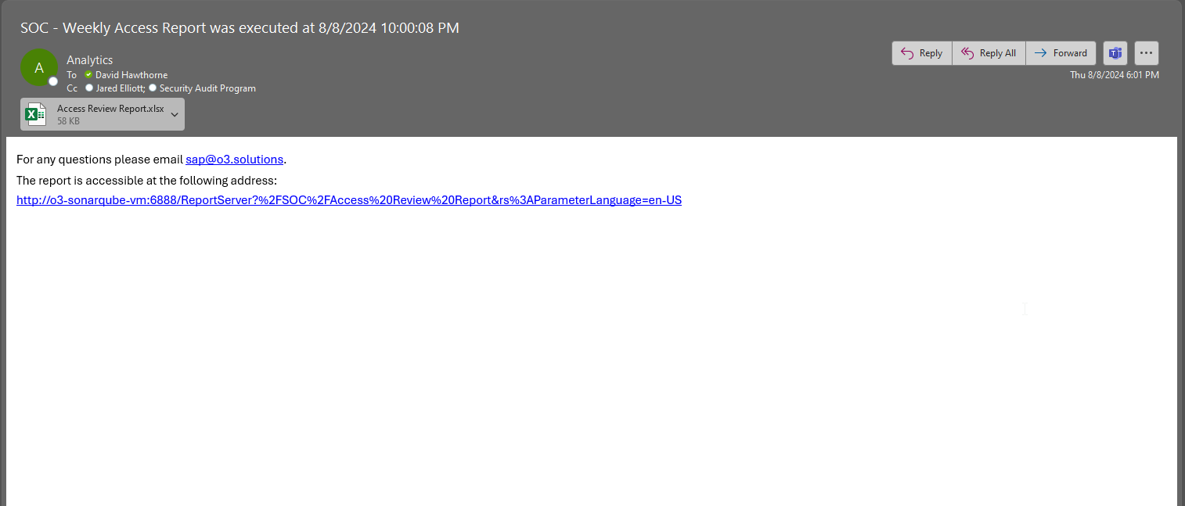
RETHINK – Access Reviews
Throw it in Excel with a few CONCAT()s and voila
I can get a delta report now!
@shellninja

Slide 22
https://github.com/prowler-cloud/prowler: Prowler is an Open Source security tool to perform AWS, Azure, Google Cloud and Kubernetes security best practices assessments, audits, incident response, continuous monitoring, hardening and forensics readiness, and also remediations!
https://wazuh.com: Unified XDR and SIEM protection for endpoints
and cloud workloads.
https://www.clamav.net: ClamAV® is an open-source antivirus engine for detecting trojans, viruses, malware & other malicious threats.
https://github.com/gravitl/netmaker: Netmaker is a platform for creating fast and secure virtual networks with WireGuard.
https://www.pfsense.org: The pfSense project is a free network firewall distribution, based on the FreeBSD operating system with a custom kernel and including third party free software packages for additional functionality. pfSense software, with the help of the package system, is able to provide the same functionality or more of common commercial firewalls.
@shellninja
Notes:
Sorry, I’m a data guy – VLOOKUP(MATCH(CONCAT))) IS MY JAM.

Slide 23
Evidence Requests
@shellninja
Notes:
Remember, easy buttons keep time linear

Slide 24
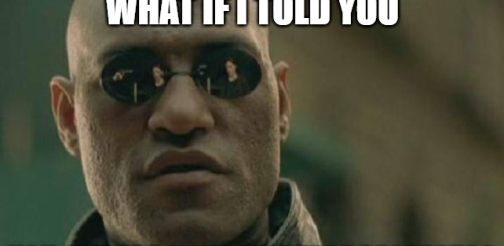
RETHINK’in
There’s an easy button?
@shellninja
Notes:
Don’t repeat yourself

Slide 25
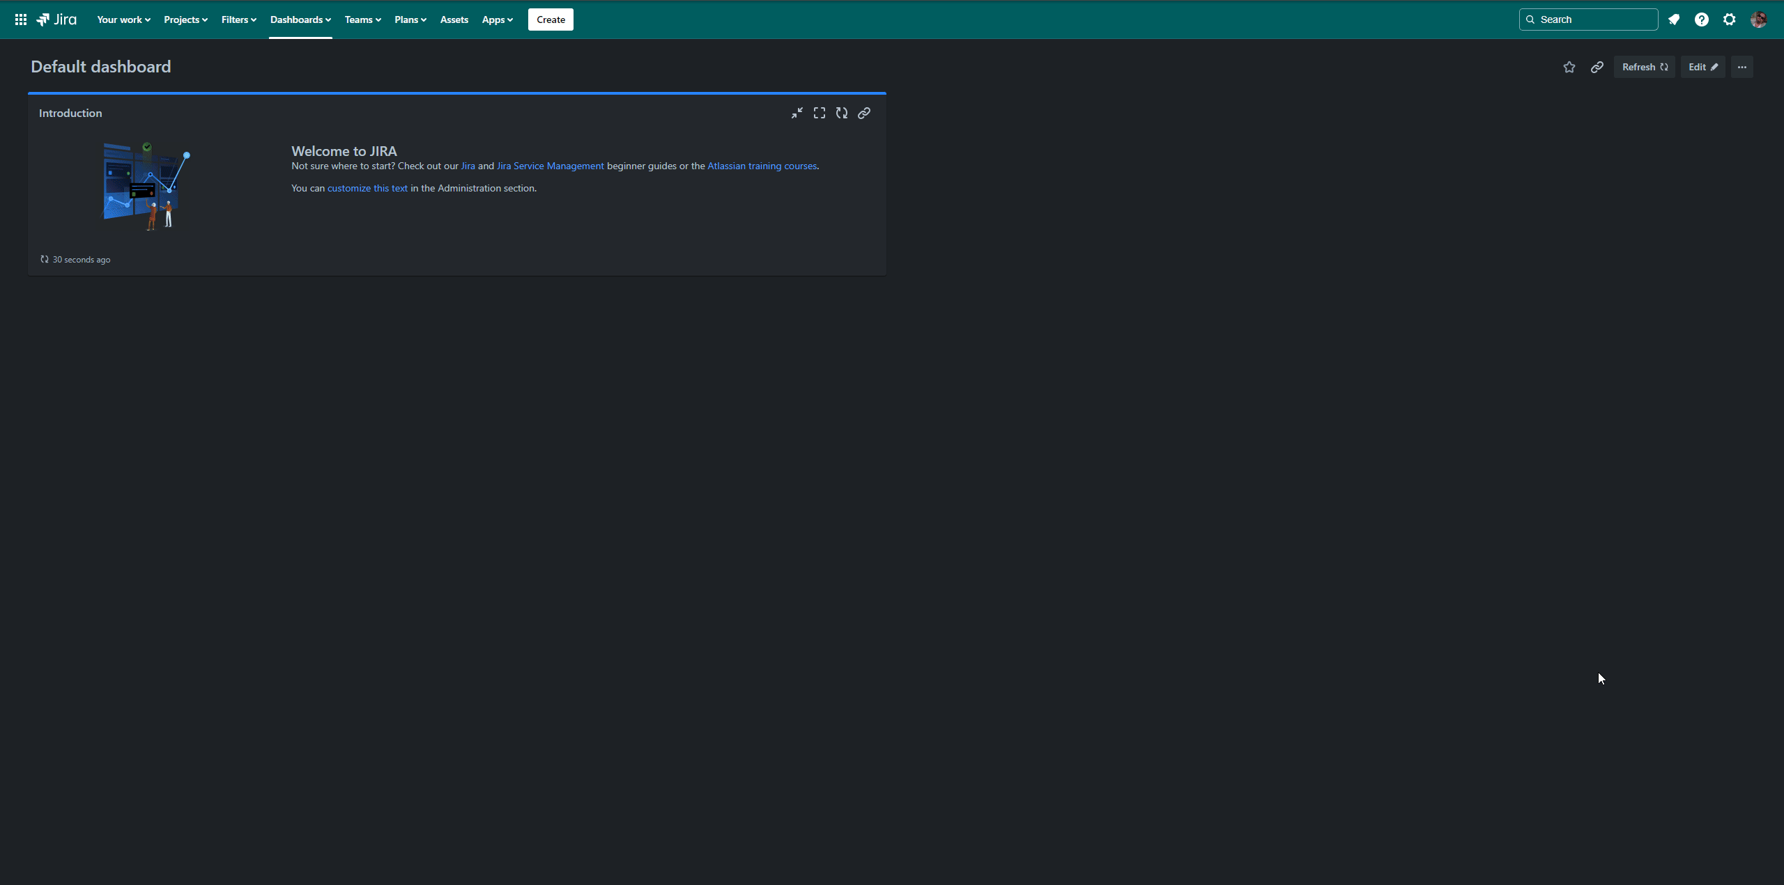
Evidence Requests are Tests
@shellninja
Notes:
Evidence requests are tests after all, eh? We already do a ton of TDD, what if we treated our evidence requests as unit tests?

Slide 26
Lessons Learned
Treat the audit as a continuous improvement exercise
Align the Change Management procedures to your development process.
It takes about six months for a feature to be adopted. Expect a year before your security culture matures
Put the policies in a LLM because you aren’t going to remember them. Use it for security questionnaires.
Pin your IRP to your comm channels
Treat security tasks like bugs in grooming a sprint – top of the list.
Don’t ignore the business side of security – you’ve focused on your in-scope assets.
Once we began owning our infrastructure new insights around FinOps emerge.
Make a mirror at the start of the year for evidence requests based on the prior audit
After a major overhaul, reach out to your cyber-risk insurance and see if you can get a discount.
@shellninja

Slide 27

Slides and Sample Code: https://github.com/shellninja/DevOpsDaysBham2024
Get in Touch:
https://davidhawthorne.com
@shellninja

